Slide 1
Getting to Know Vivado
Course Workbook

Slide 2
Table of Contents
About this Workbook | Slide 3
Pre-Lab: Workshop Pre-requisites | Slide 4
Lab 4: Understanding Vivado | Slide 7

Slide 3
About this Workbook
This workbook is designed to be used in conjunction with the Getting to Know Vivado course.
The contents of this workbook are created by Adiuvo Engineering & Training, Ltd.
If you have any questions about the contents, or need assistance, please contact Adam Taylor at adam@adiuvoengineering.com.

Slide 4
Pre-Lab Workshop Pre-requisites

Slide 5
Required Hardware
Pre-Lab
There is no required hardware for this course.

Slide 6
Downloads and Installations
Pre-Lab
Step 1 – Download and install the following at least one day prior to the workshop. This may take a significant amount of time and drive space.
Vitis 2021.1 | Download
Source Project Files | Download

Slide 7
Lab 4 Overview and Introduction to Vivado

Slide 8
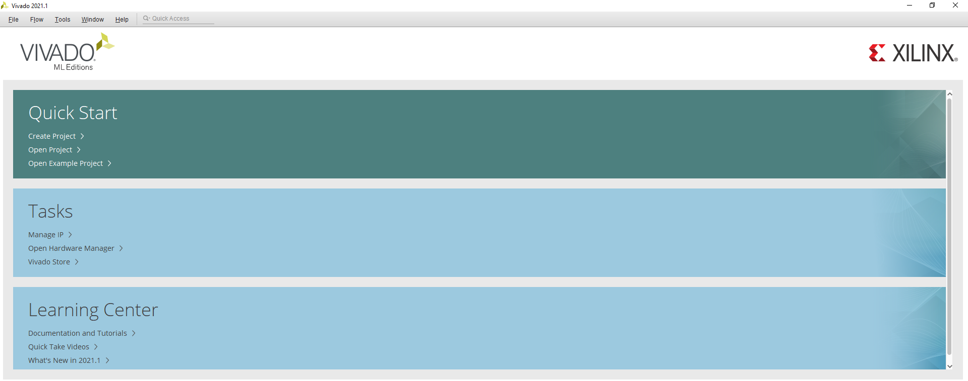
Lab 4: Overview and Introduction to Vivado
Lab 4
Step 1 – Open Vivado 2021.1.

Slide 9
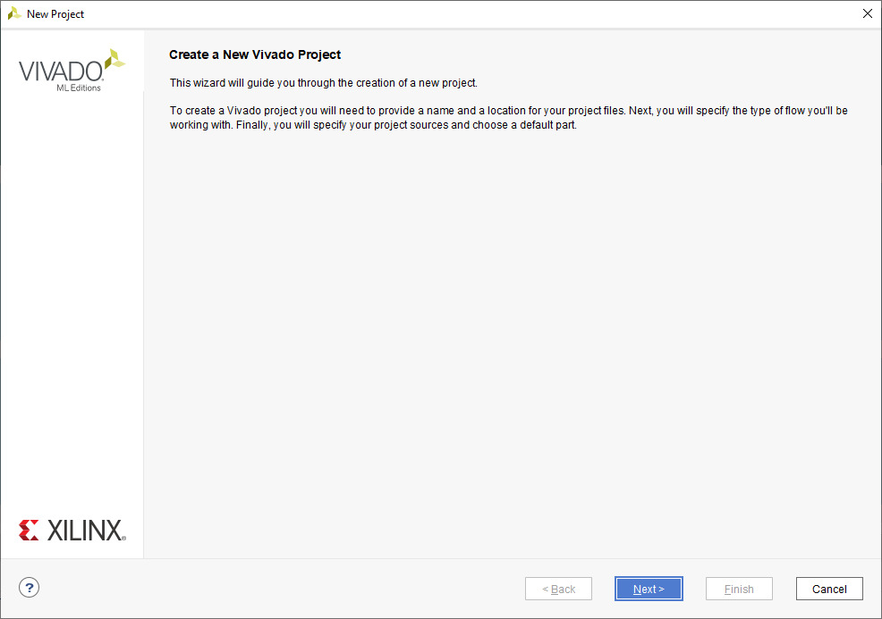
Lab 4: Overview and Introduction to Vivado
Lab 4
Step 2 – Click on Create Project – This will open the New Project Wizard – Click Next.

Slide 10
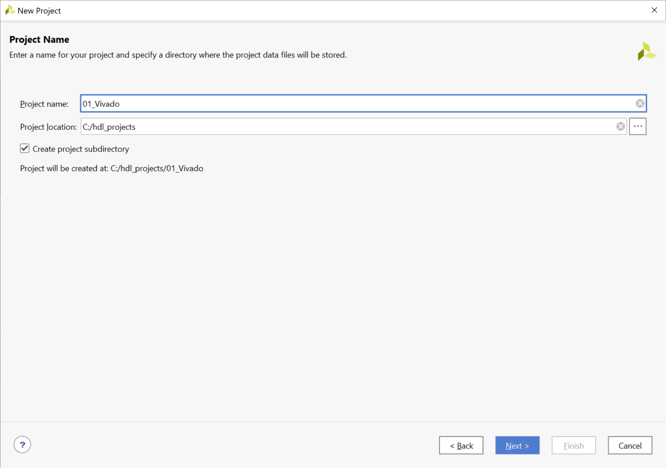
Lab 4: Overview and Introduction to Vivado
Lab 4
Step 3 – Enter the project name of “01_Vivado” and select the location you want to save the project. Click Next

Slide 11
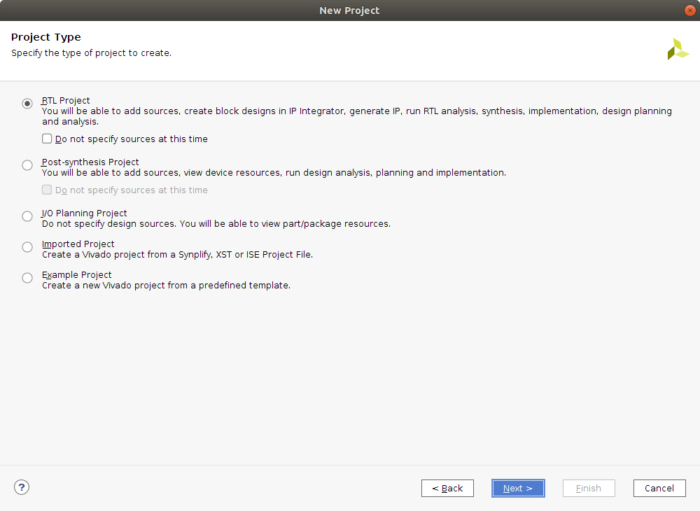
Lab 4: Overview and Introduction to Vivado
Lab 4
Step 4 – Select RTL Project. Check Do not specify sources is unticked

Slide 12
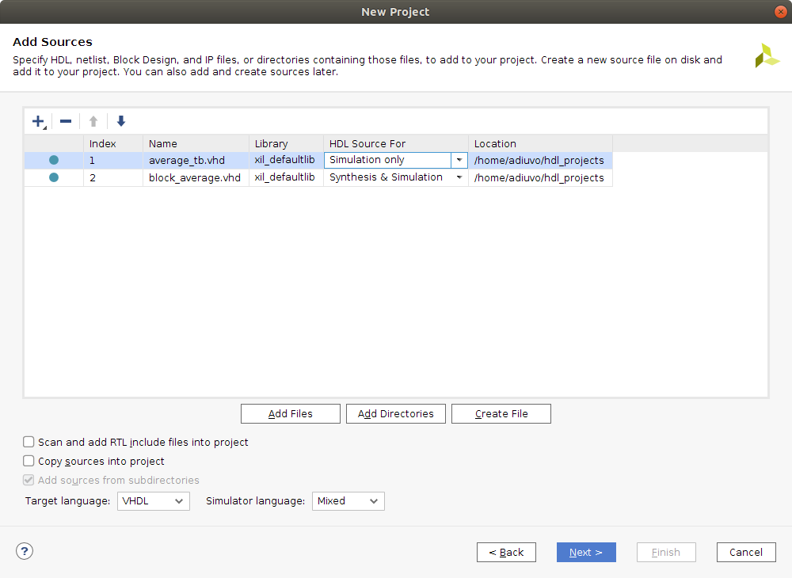
Lab 4: Overview and Introduction to Vivado
Lab 4
Step 5 – Click ADD FILES and select the two files downloaded from Github. For the file average_tb.vhd, change the HDL source to Simulation Only. Click Next

Slide 13
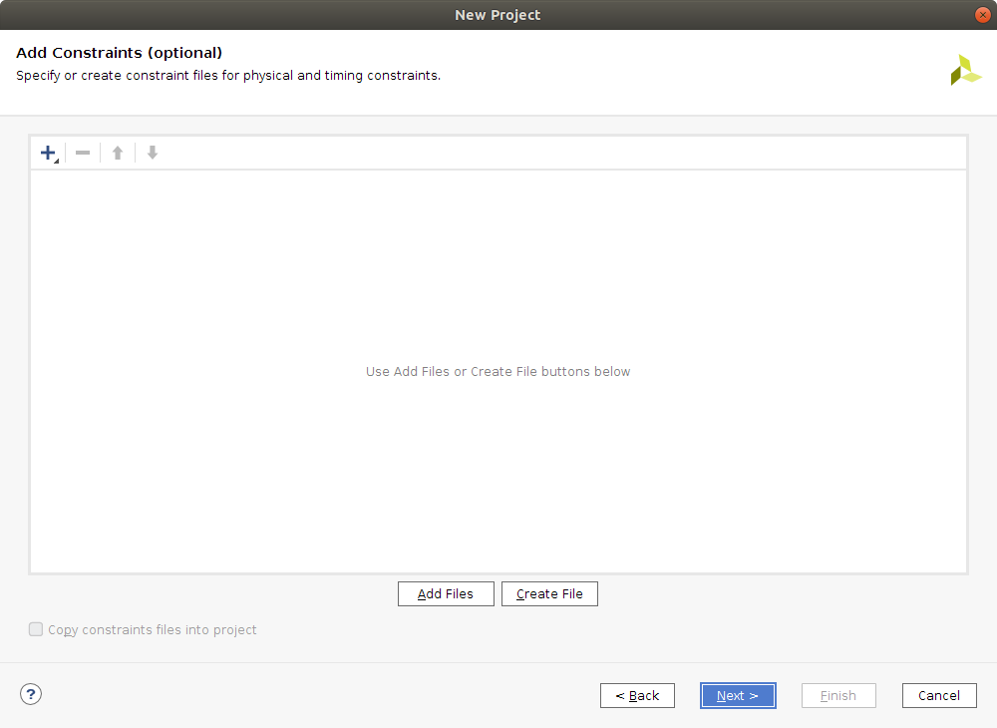
Lab 4: Overview and Introduction to Vivado
Lab 4
Step 6 – At this time we do not want to add any constraints files. Click Next.

Slide 14
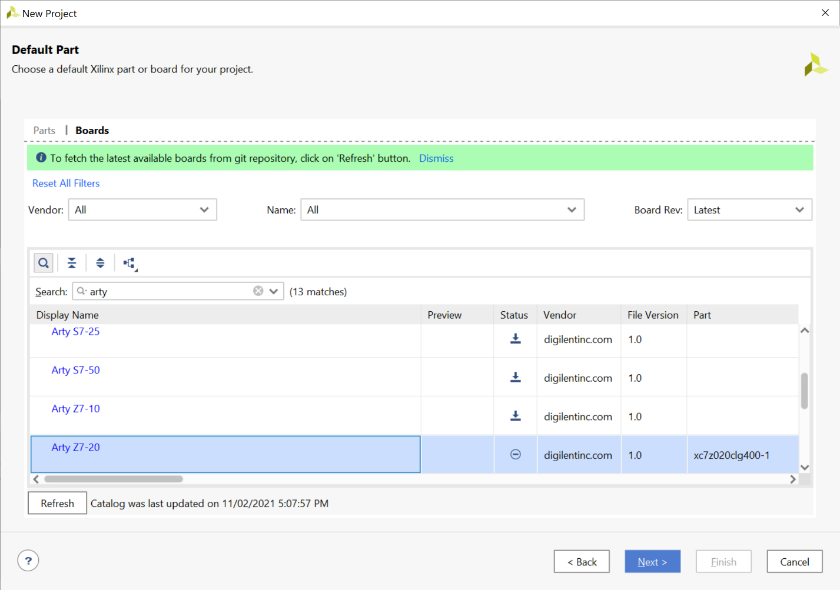
Lab 4: Overview and Introduction to Vivado
Lab 4
Step 7 – Select the Arty Z7-20 and click Next.

Slide 15
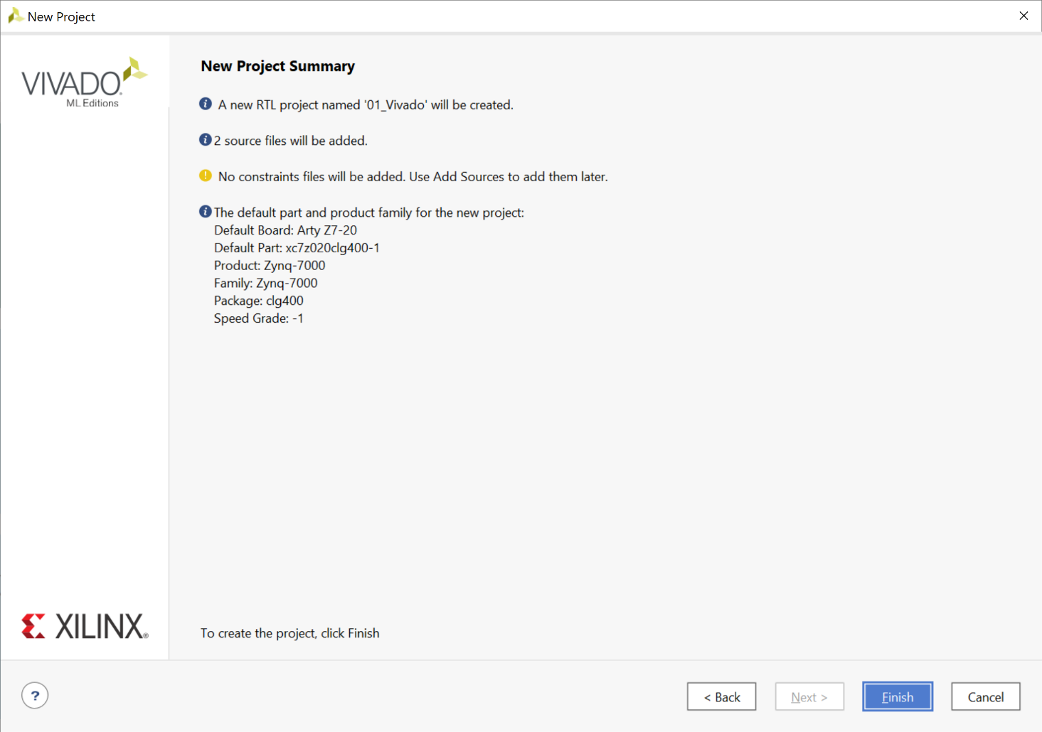
Lab 4: Overview and Introduction to Vivado
Lab 4
Step 8 – On the project summary tab, select Finish.

Slide 16
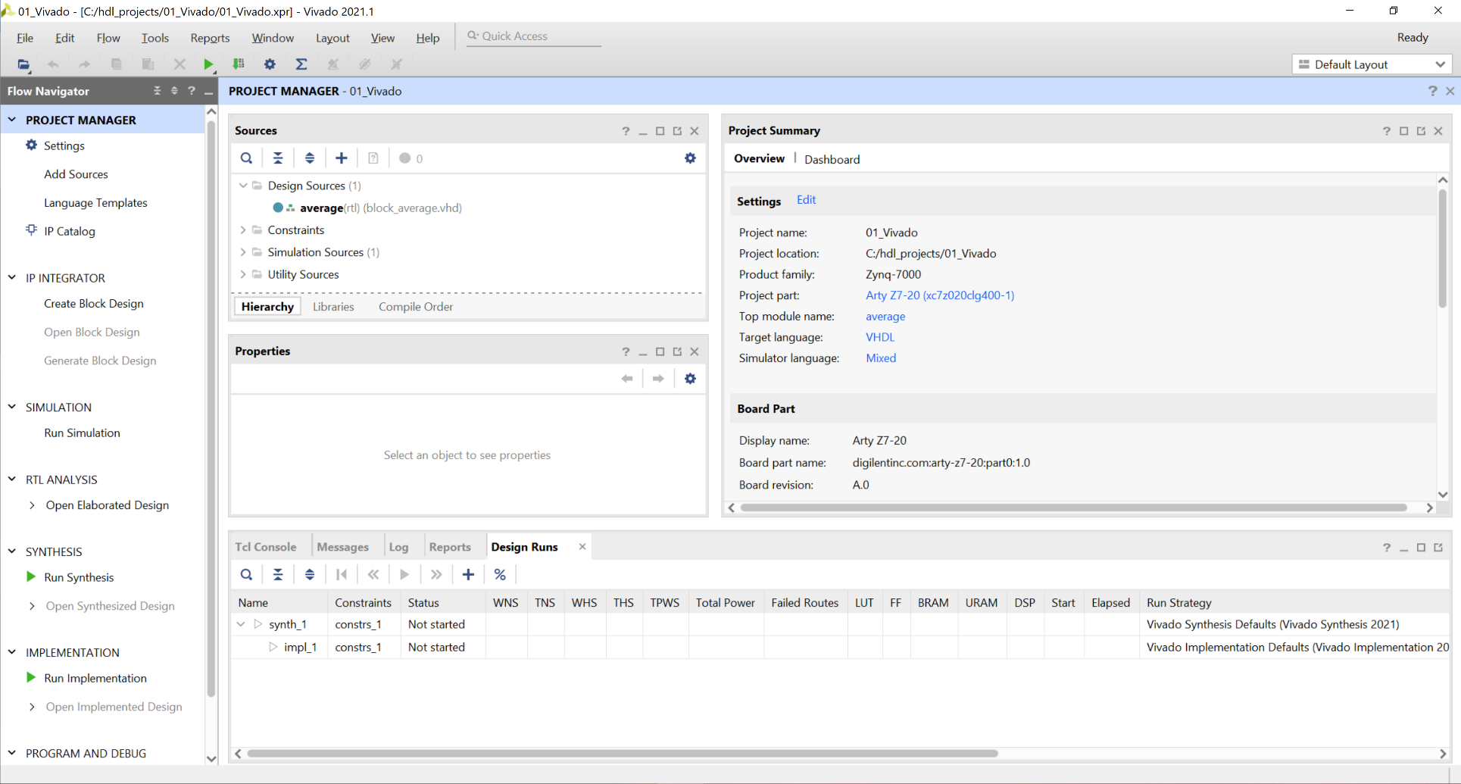
Lab 4: Overview and Introduction to Vivado
Lab 4
Step 9 – This will open Vivado in the project manager view.

Slide 17
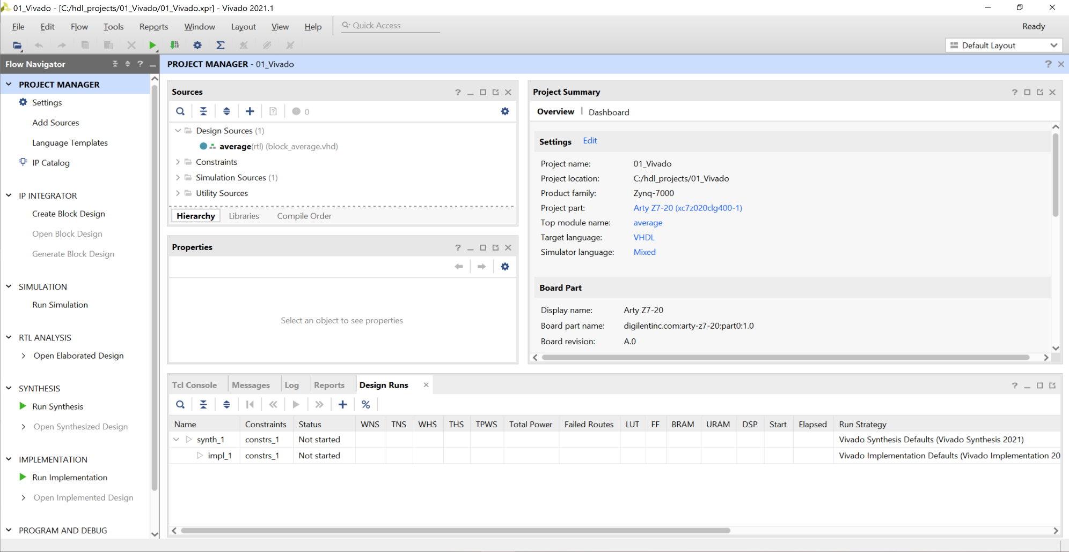
Lab 4: Overview and Introduction to Vivado
Lab 4
Step 10 – Expand the Simulation Sources.

Slide 18
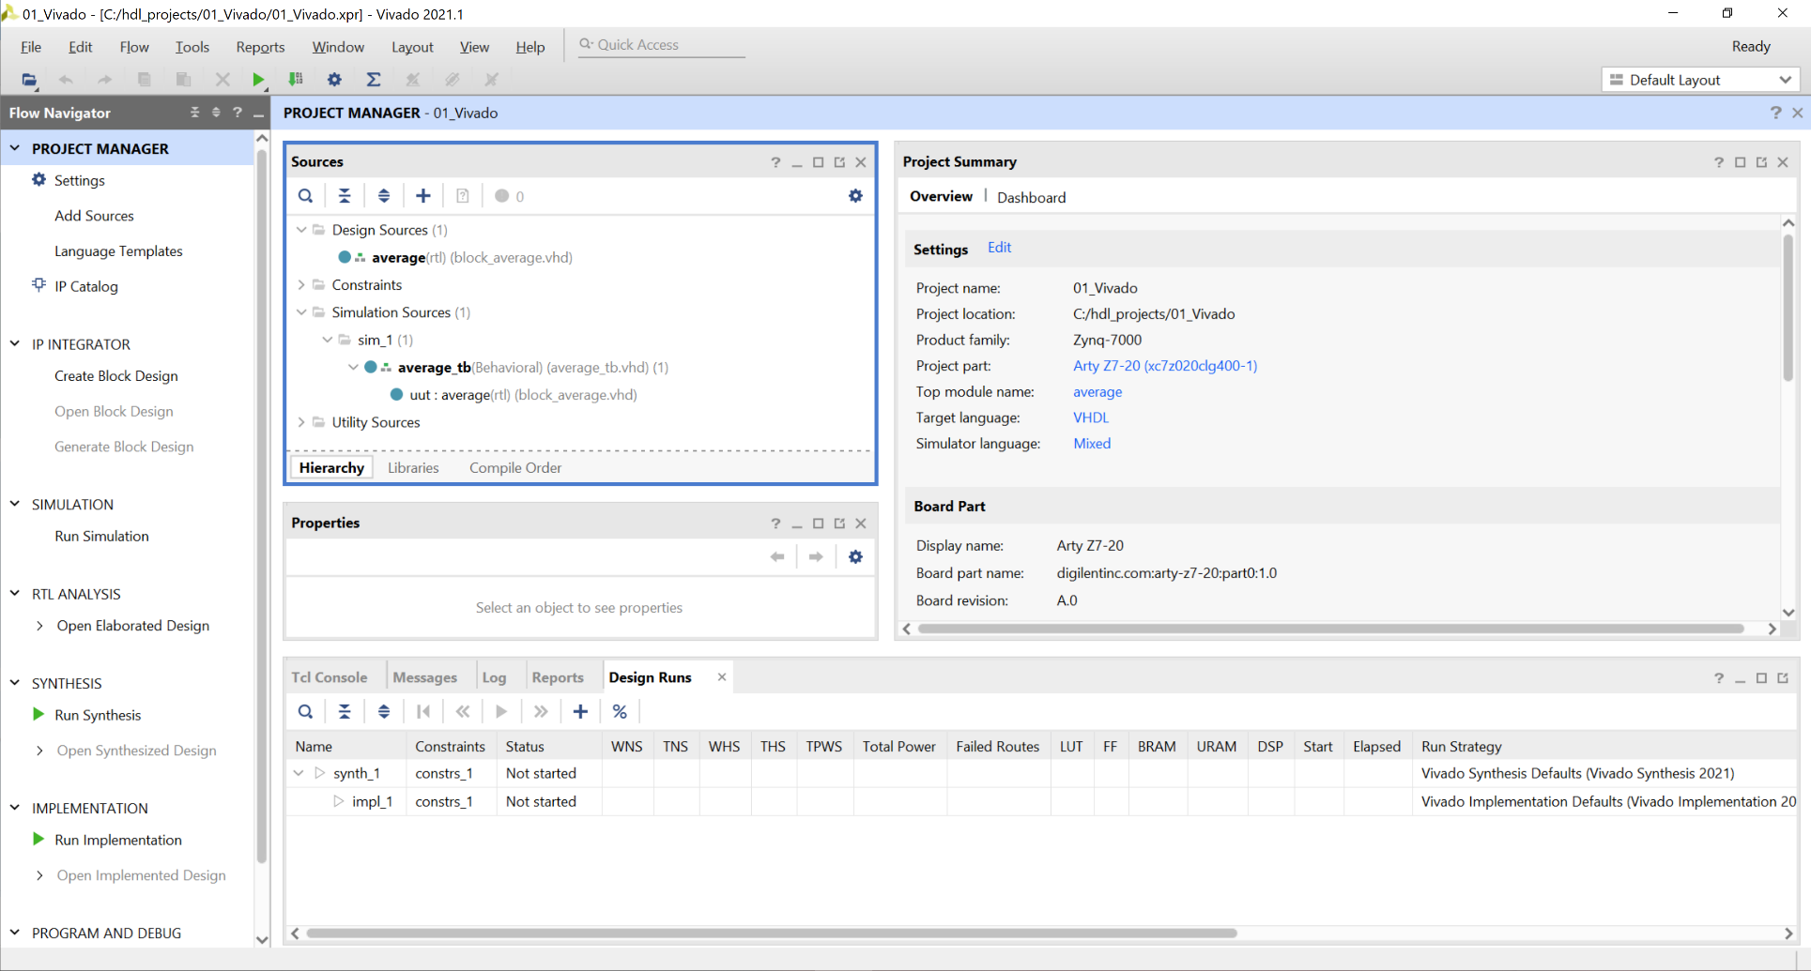
Lab 4: Overview and Introduction to Vivado
Lab 4
Step 11 – This will show the test bench and the design source to be simulated.

Slide 19
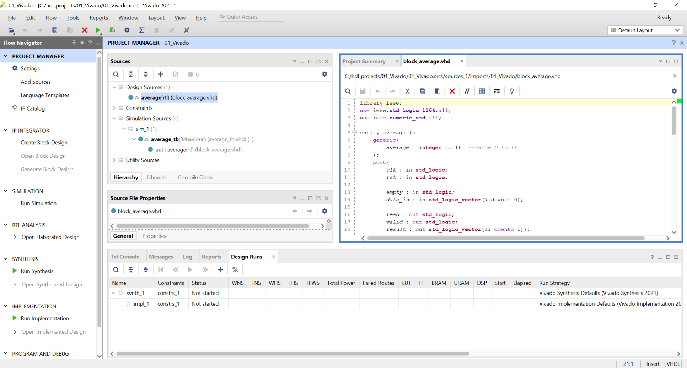
Lab 4: Overview and Introduction to Vivado
Lab 4
Step 12 – Double clicking on the VHDL files will open the source for inspection.

Slide 20
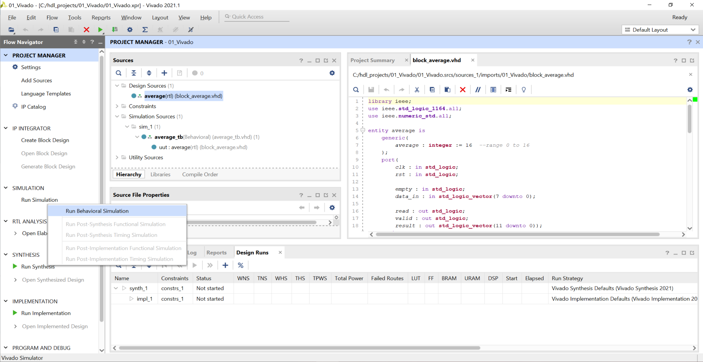
Lab 4: Overview and Introduction to Vivado
Lab 4
Step 13 – To run a simulation, click on Run Simulation and select Run Behavioral Simulation.

Slide 21
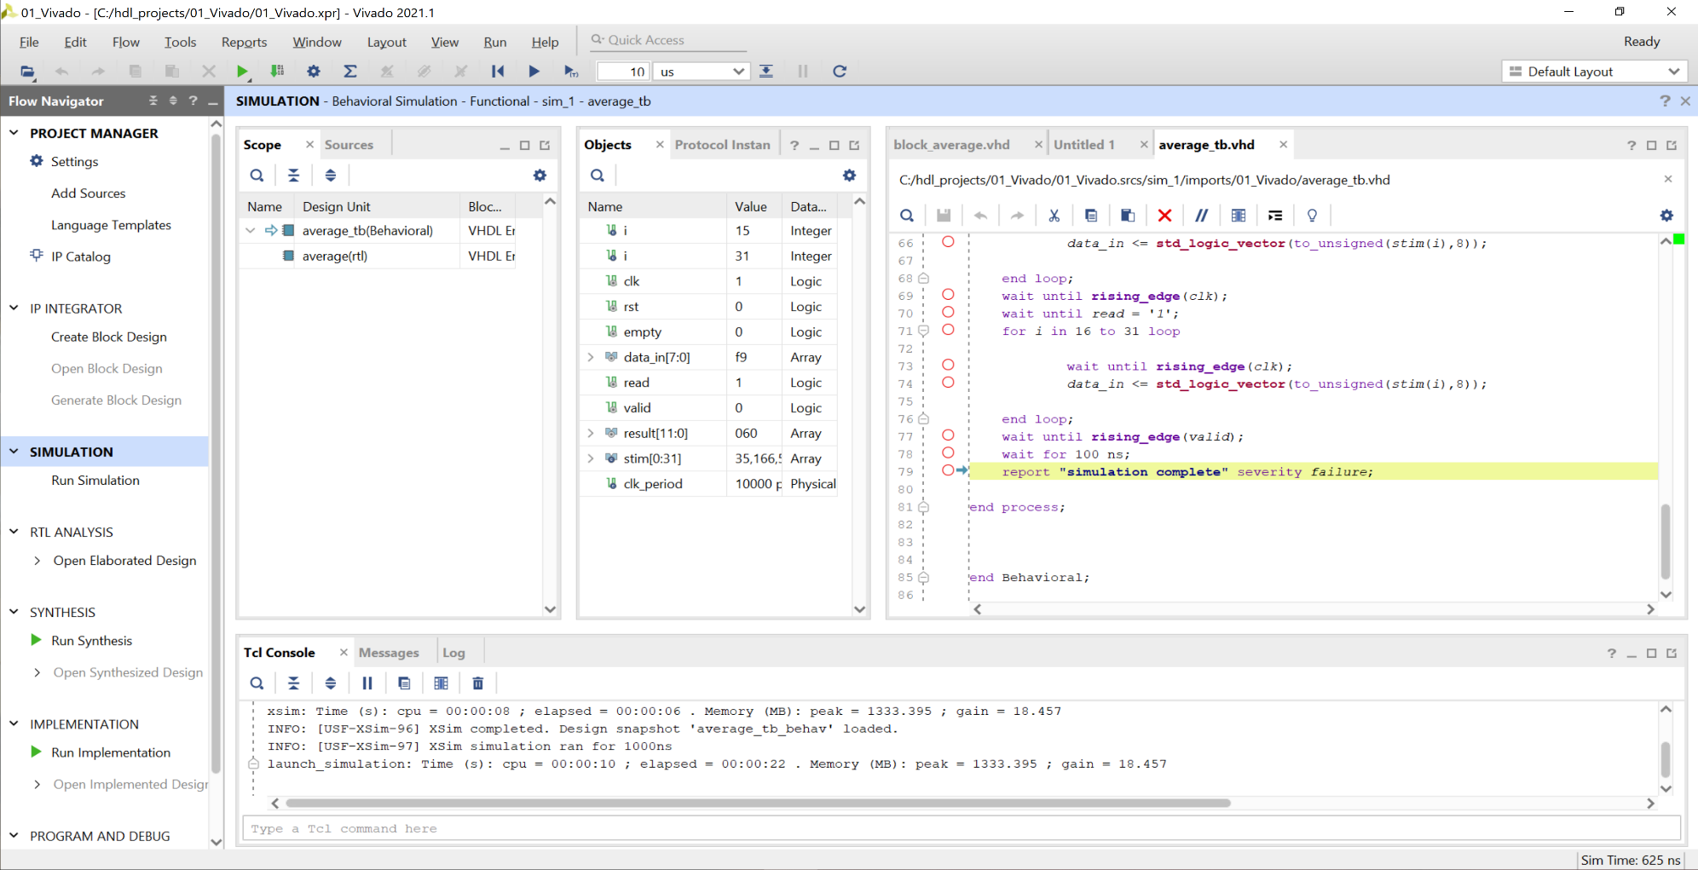
Lab 4: Overview and Introduction to Vivado
Lab 4
Step 14 – This will open the behavioral simulation view. Note the scope and objects.

Slide 22
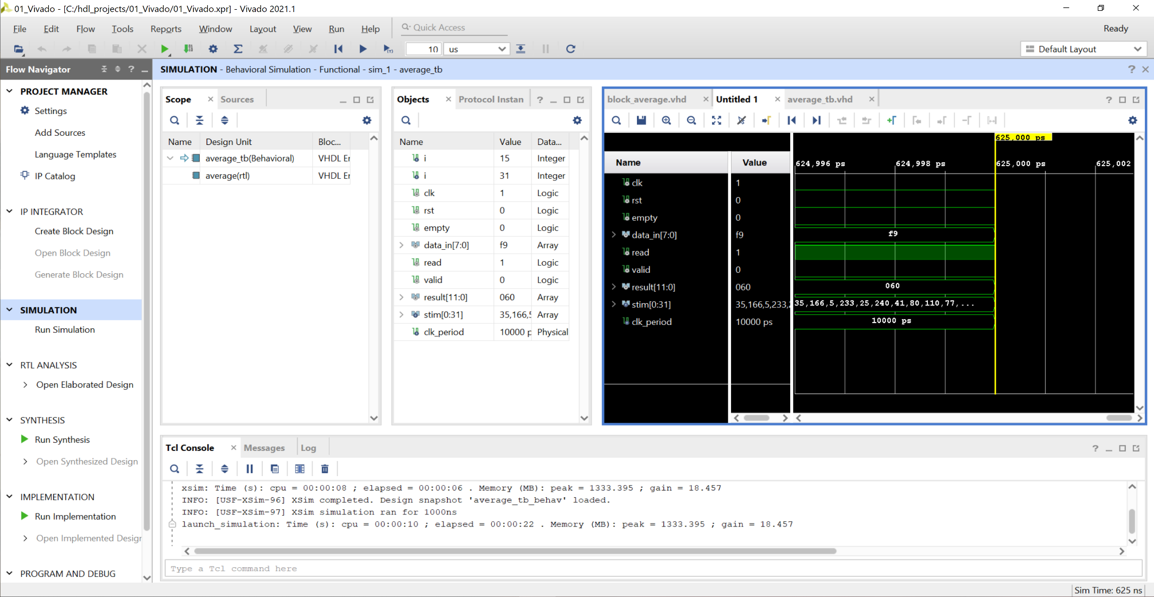
Lab 4: Overview and Introduction to Vivado
Lab 4
Step 15 – Click on the Untitled* tab to see the waveform of the simulation. Note this view shows the signals defined within the test bench only, not the Unit Under Test.

Slide 23
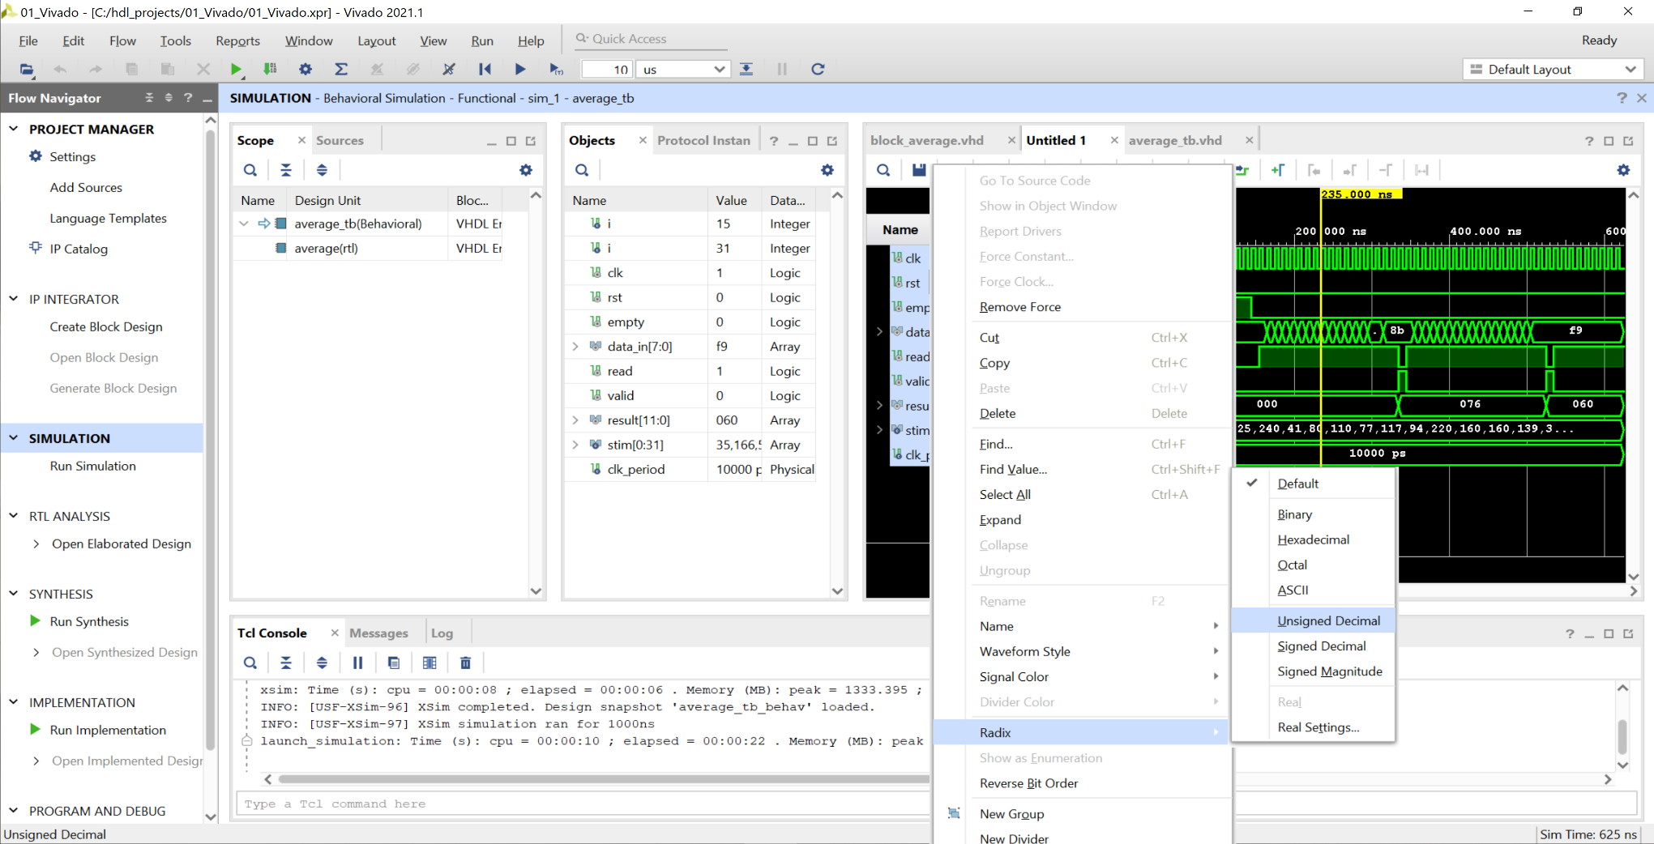
Lab 4: Overview and Introduction to Vivado
Lab 4
Step 16 – At the moment, the results are in hexadecimal but they make more sense in decimal. Select all the signals, right click, and select unsigned decimal from the radix.

Slide 24
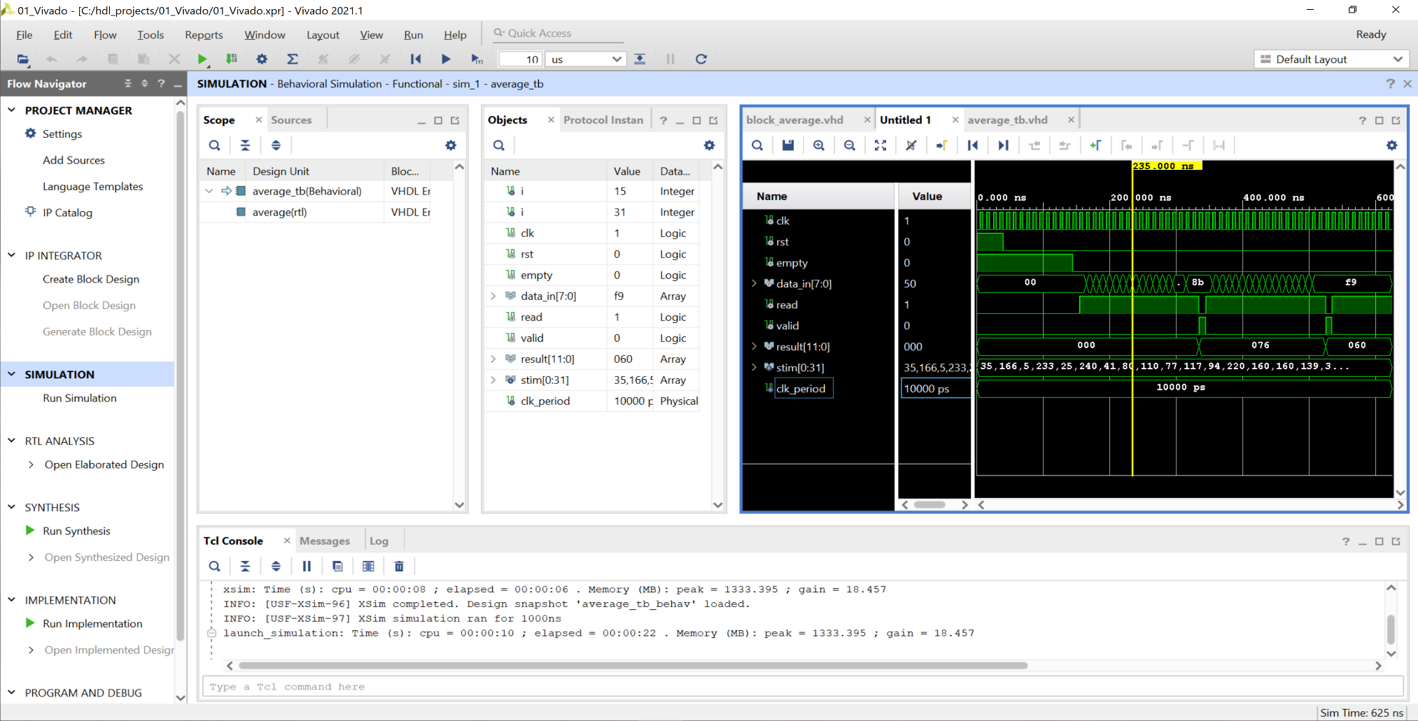
Lab 4: Overview and Introduction to Vivado
Lab 4
Step 17 – This will change the results to decimal. Correct operation has result showing 118 then 96. This is the block average of 16 input values.

Slide 25
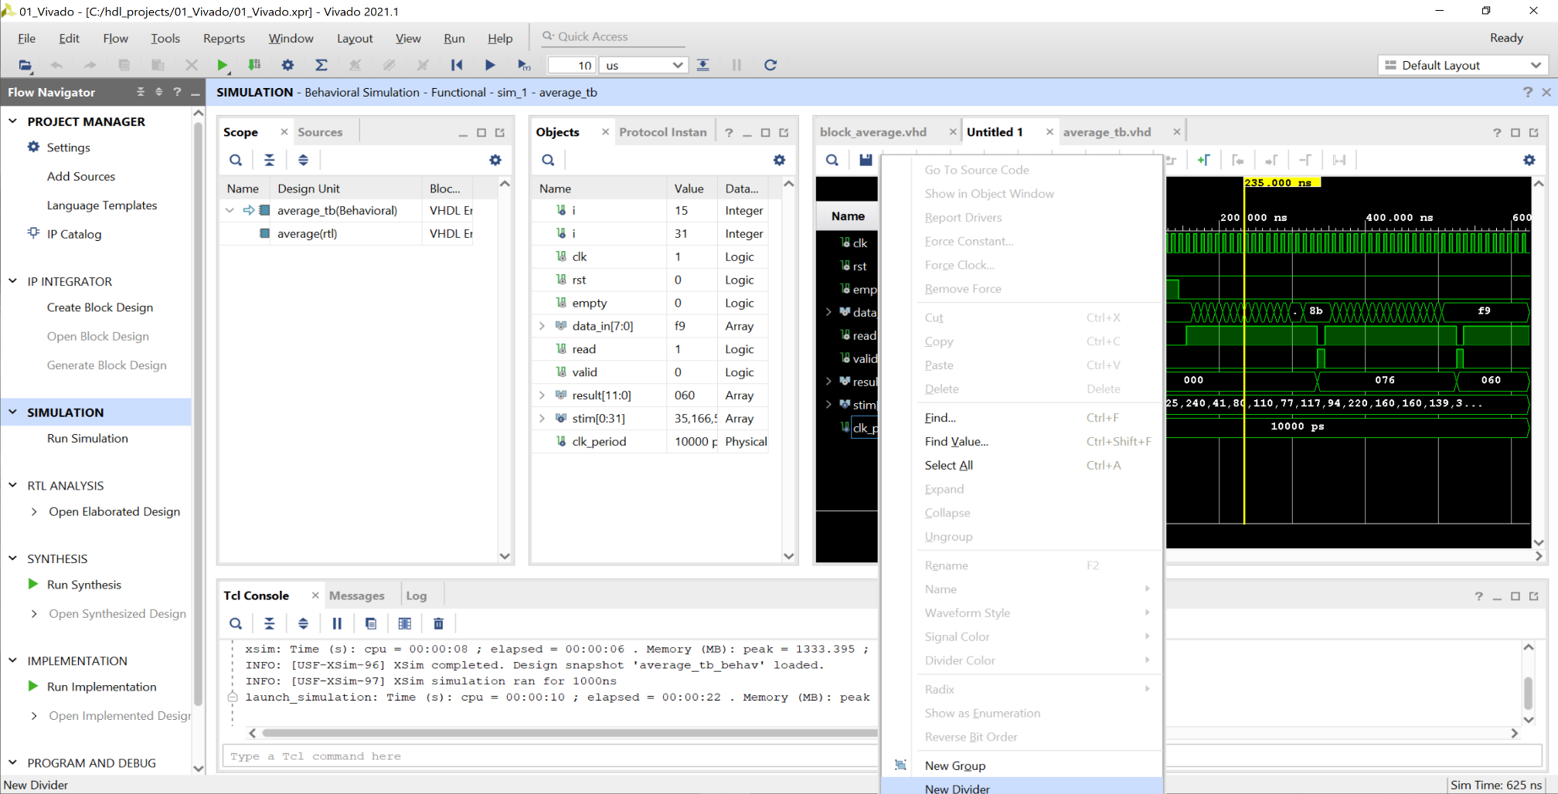
Lab 4: Overview and Introduction to Vivado
Lab 4
Step 18 – Often we want to be able to see the signals in the UUT. To do this, first let’s insert a divider. Right click on the bottom signal and select New Divider.

Slide 26
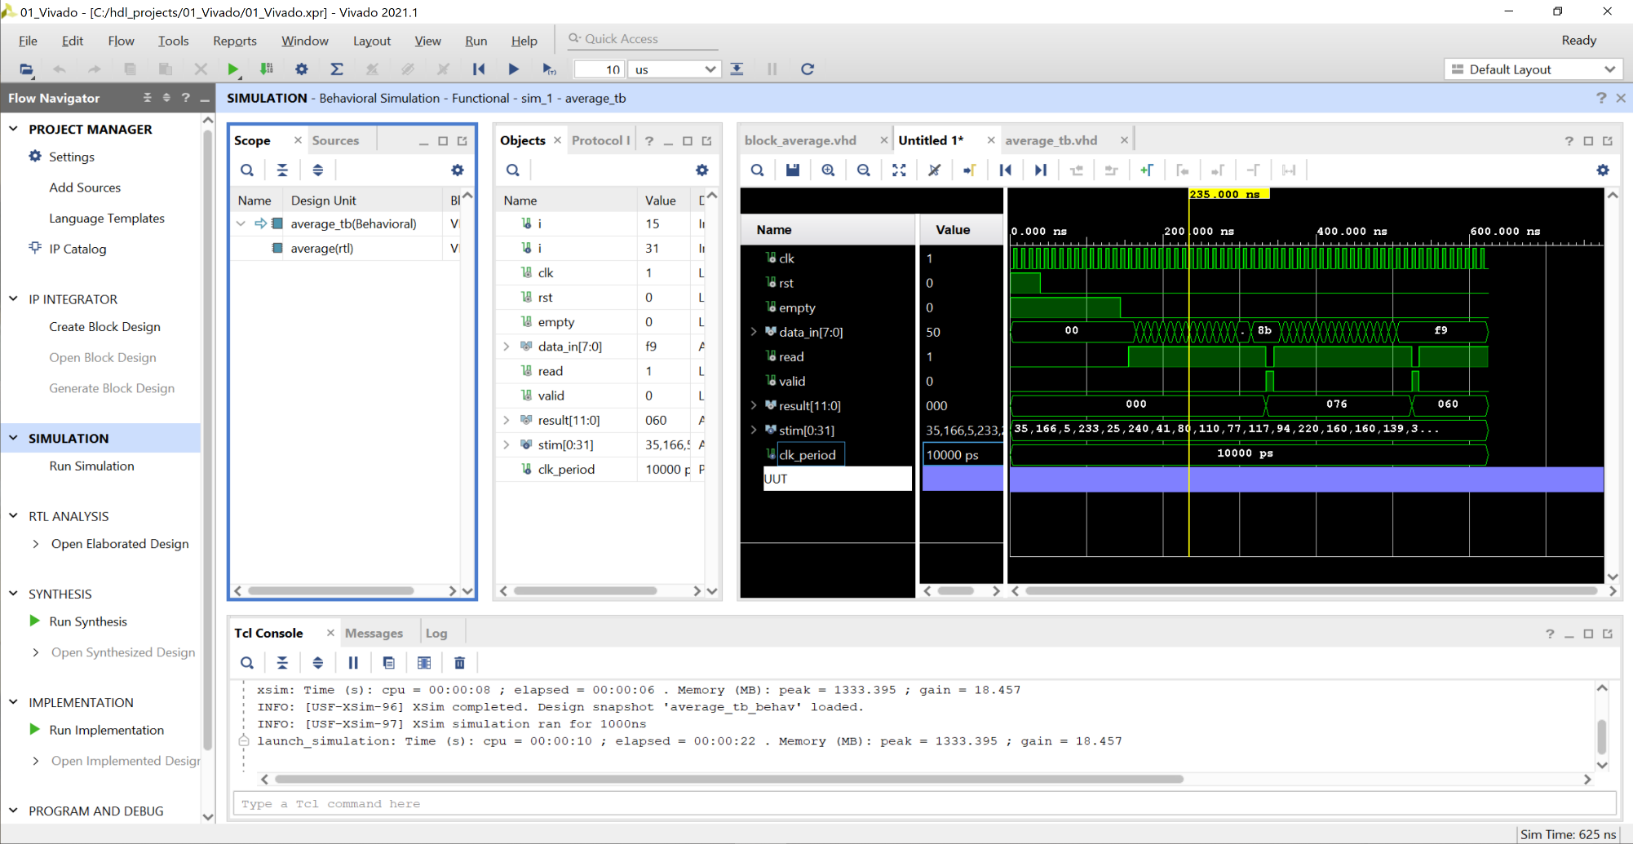
Lab 4: Overview and Introduction to Vivado
Lab 4
Step 19 – When prompted, enter the name UUT and you will see the new divider in the waveform.

Slide 27
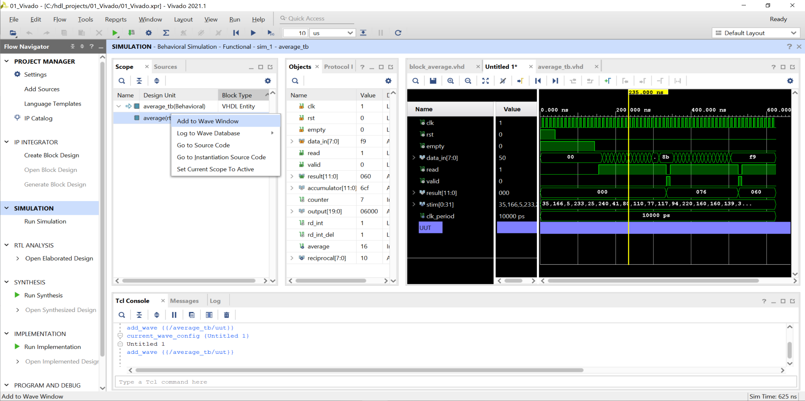
Lab 4: Overview and Introduction to Vivado
Lab 4
Step 20 – To add in the UUT, right click on the UUT under the scope and select Add to Wave Window.

Slide 28
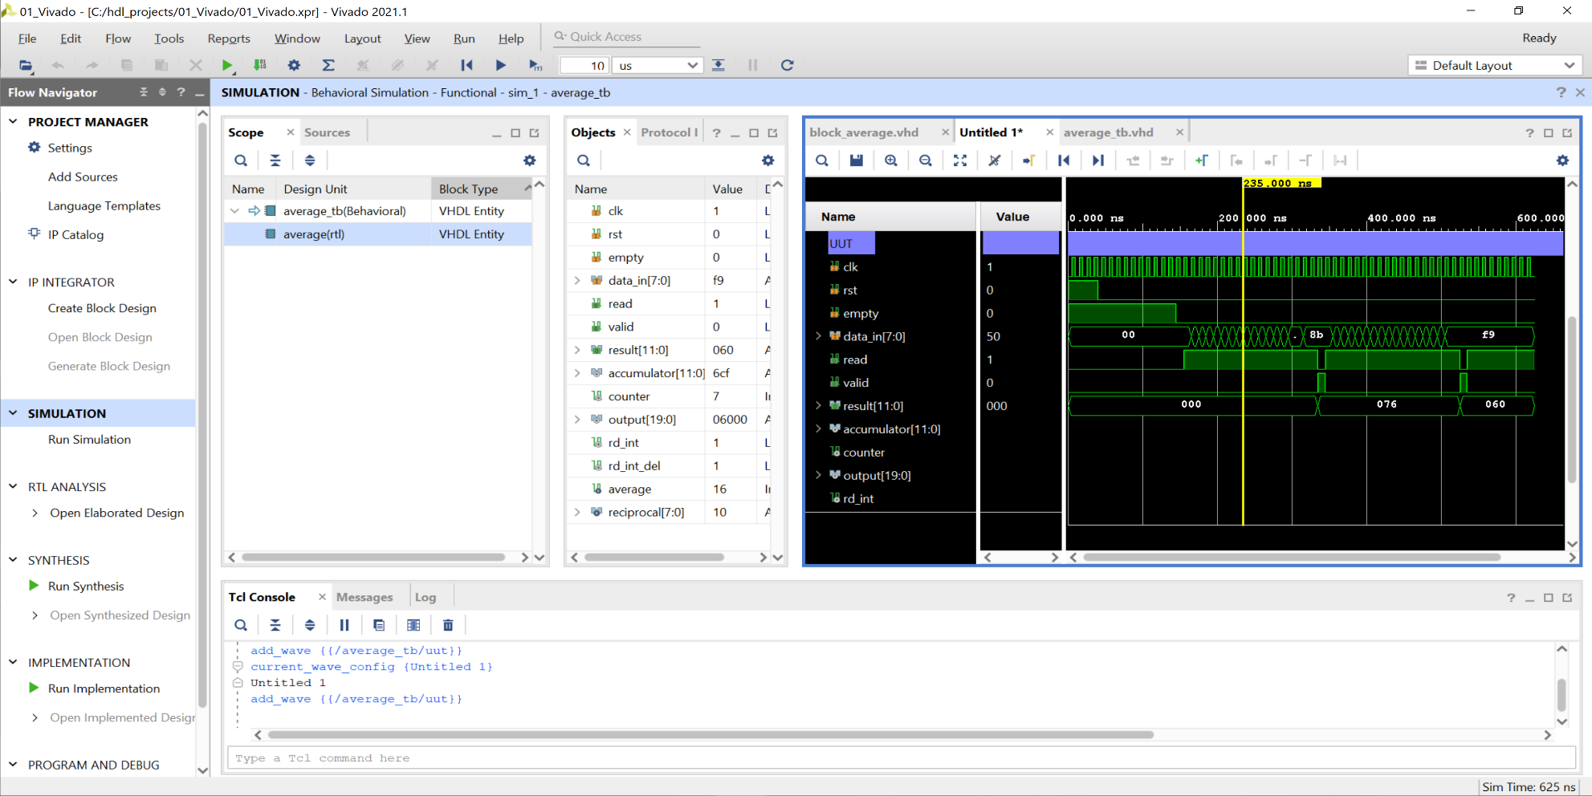
Lab 4: Overview and Introduction to Vivado
Lab 4
Step 21 – This will add in the UUT signals, however, some information may be missing as it was not saved during the simulation.

Slide 29
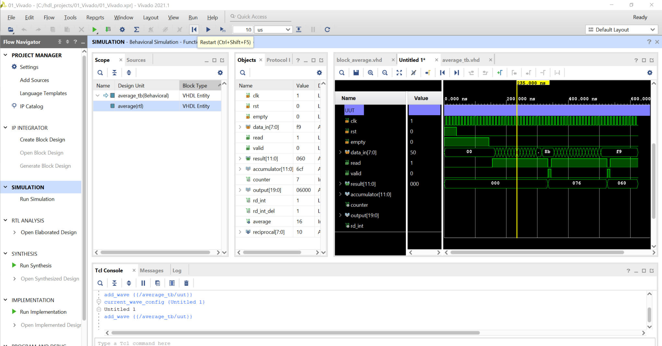
Lab 4: Overview and Introduction to Vivado
Lab 4
Step 22 – To add in the missing waveform, we need to restart the simulation. Select Restart from menu bar.

Slide 30
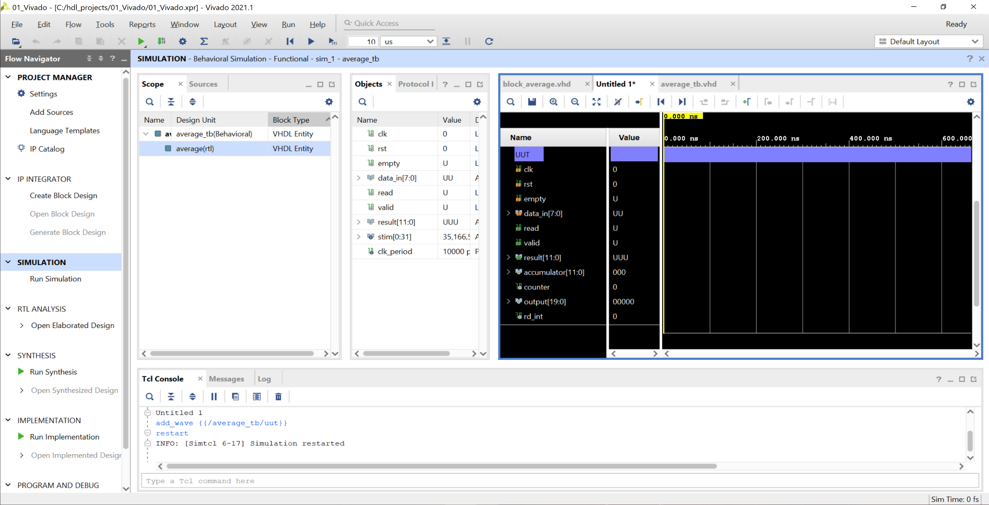
Lab 4: Overview and Introduction to Vivado
Lab 4
Step 23 – This will clear all waveform data and restart the simulation.

Slide 31
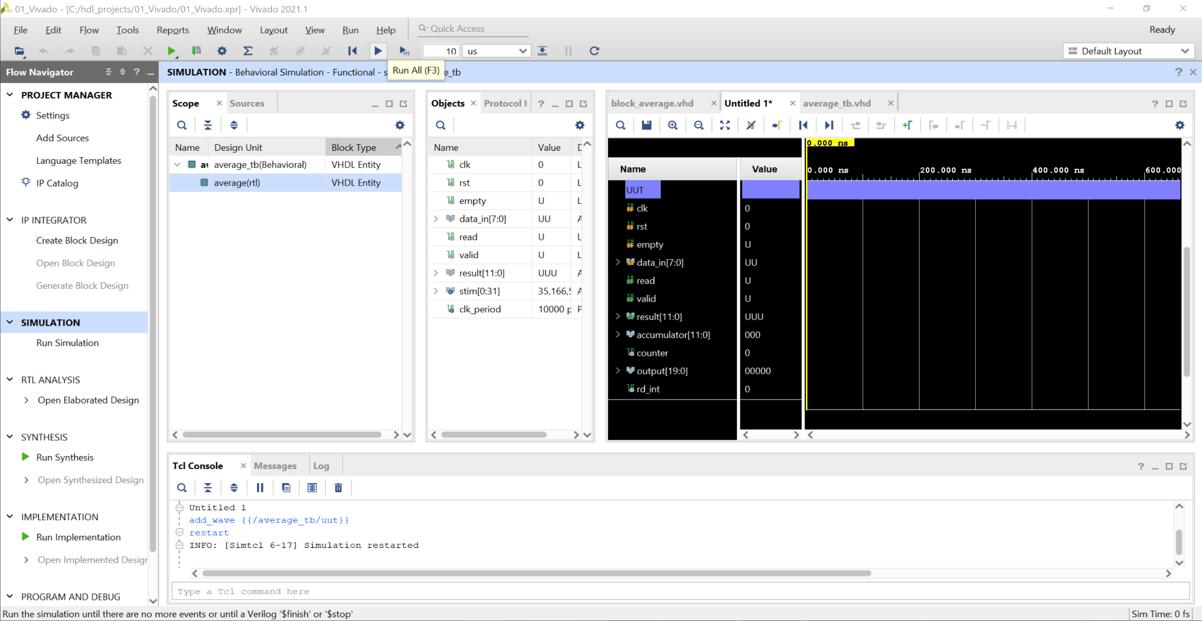
Lab 4: Overview and Introduction to Vivado
Lab 4
Step 24 – To rerun the simulation, select the Run button on the menu. The simulation will stop automatically.

Slide 32
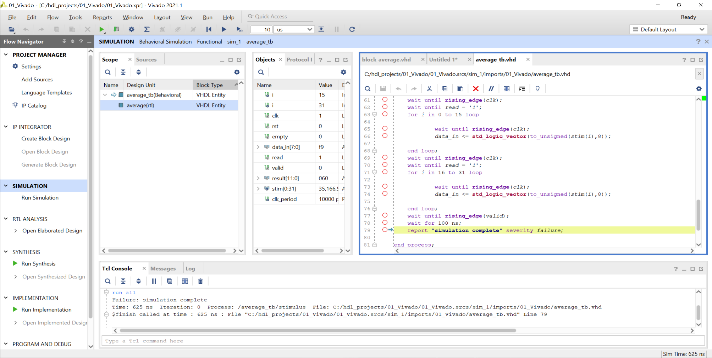
Lab 4: Overview and Introduction to Vivado
Lab 4
Step 25 – When the simulation completes, you will see the highlighted line in the test bench.

Slide 33
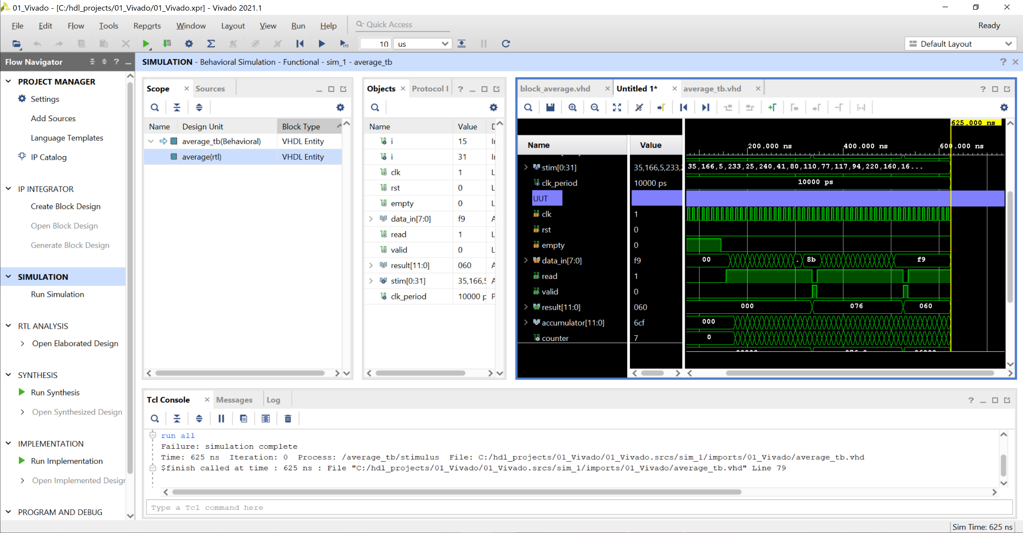
Lab 4: Overview and Introduction to Vivado
Lab 4
Step 26 – Selecting the waveform tab again will show all the signals for the UUT.

Slide 34
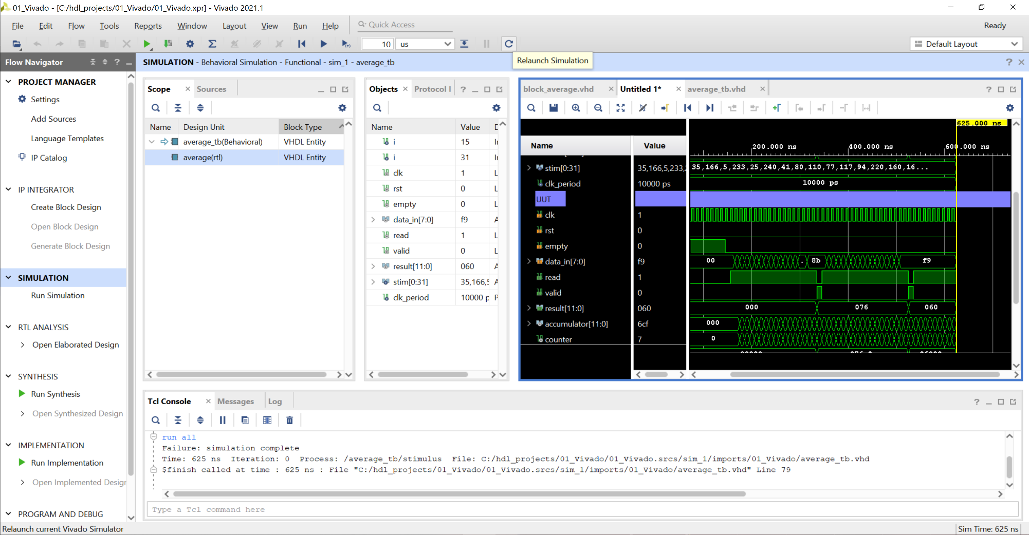
Lab 4: Overview and Introduction to Vivado
Lab 4
Step 27 – If you make changes to the source code, you need to relaunch the simulation. This can be achieved using the relaunch button on the menu.

Slide 35
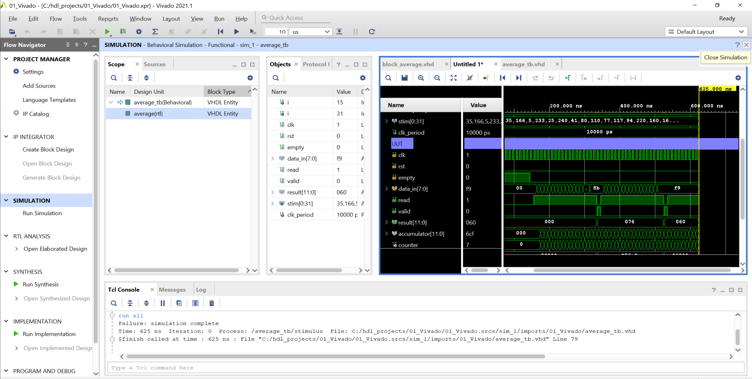
Lab 4: Overview and Introduction to Vivado
Lab 4
Step 28 – With the simulation complete, we are now ready to implement the design. Close the simulation view.

Slide 36
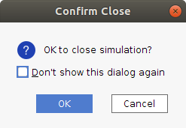
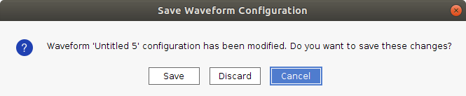
Lab 4: Overview and Introduction to Vivado
Lab 4
Step 29 – When asked to confirm, click OK. If a save waveform dialog pops up, select Discard.

Slide 37
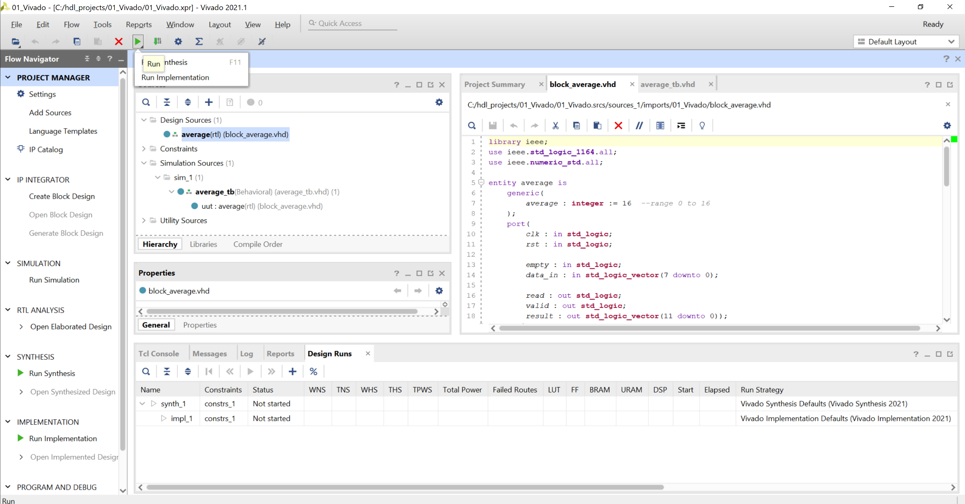
Lab 4: Overview and Introduction to Vivado
Lab 4
Step 30 – To synthesize the design, click the green run arrow and select Run Synthesis.

Slide 38
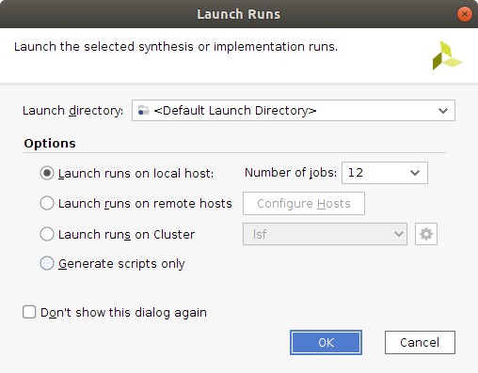
Lab 4: Overview and Introduction to Vivado
Lab 4
Step 31 – On the Launch Runs dialog, select the number of jobs you want to run on your system and click OK.

Slide 39
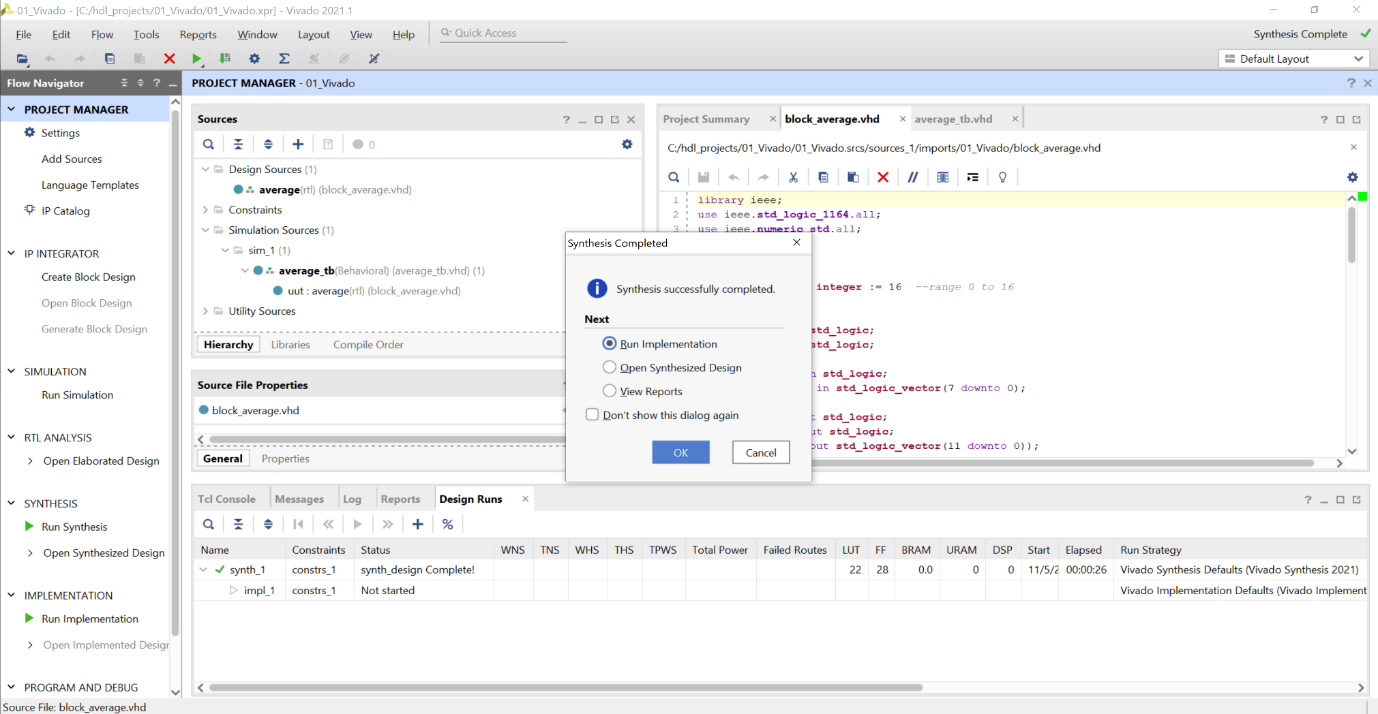
Lab 4: Overview and Introduction to Vivado
Lab 4
Step 32 – When synthesis is complete, you will see a dialog box appear.

Slide 40
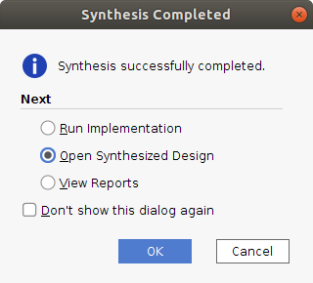
Lab 4: Overview and Introduction to Vivado
Lab 4
Step 33 – Select Open Synthesized Design.

Slide 41
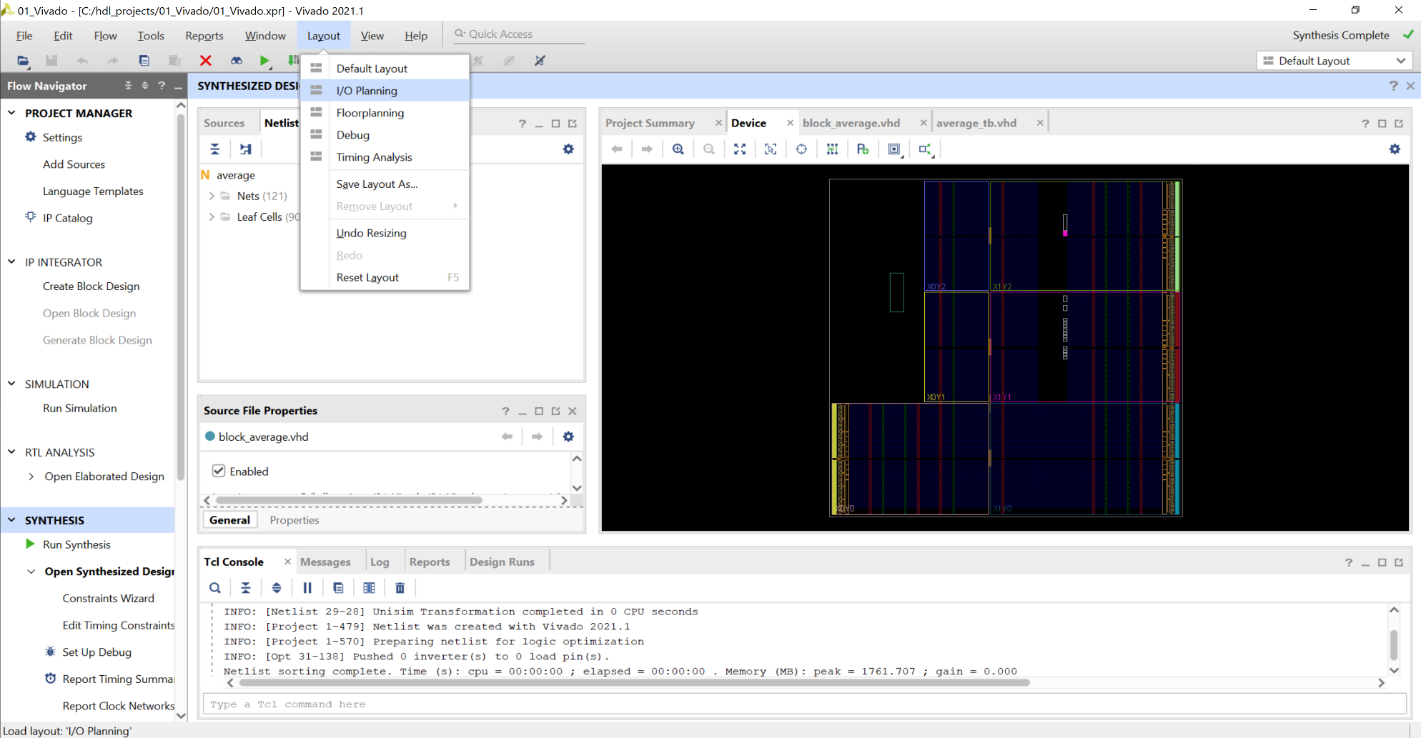
Lab 4: Overview and Introduction to Vivado
Lab 4
Step 34 – This will open the synthesis view. From the menu layout, select I/O Planning.

Slide 42
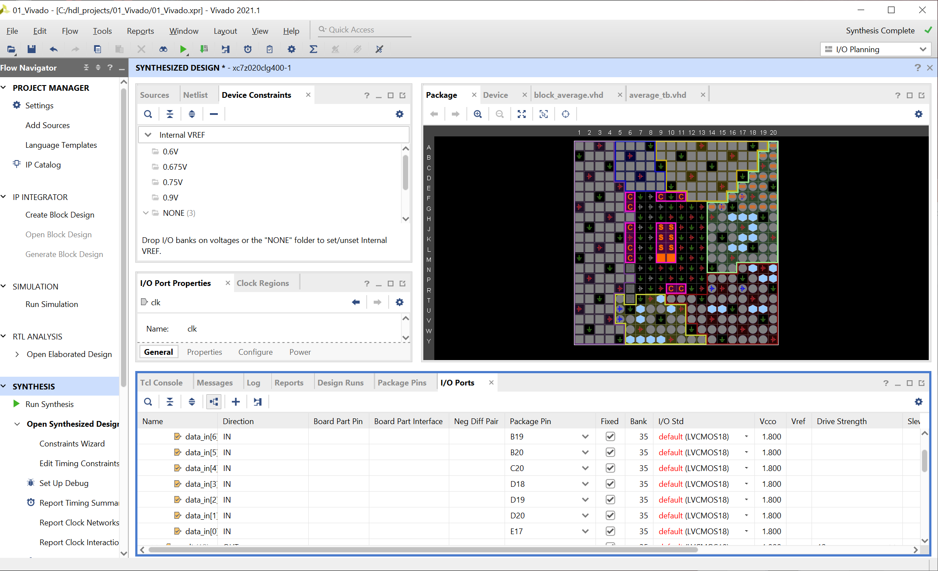
Lab 4: Overview and Introduction to Vivado
Lab 4
Step 35 – Expand the Data_In, Result and Scalar Ports and assign them to pins. All EXCEPT the clock pin can be assigned to any pin.

Slide 43
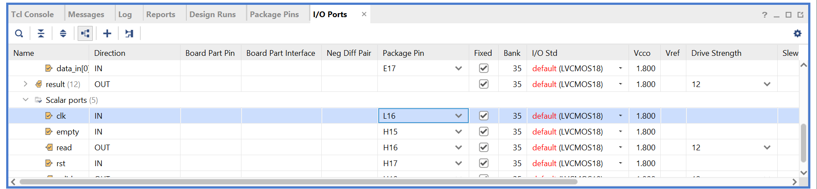
Lab 4: Overview and Introduction to Vivado
Lab 4
Step 36 – Assign the clock pin to L16. Clocks have to be assigned to clock capable pins.

Slide 44
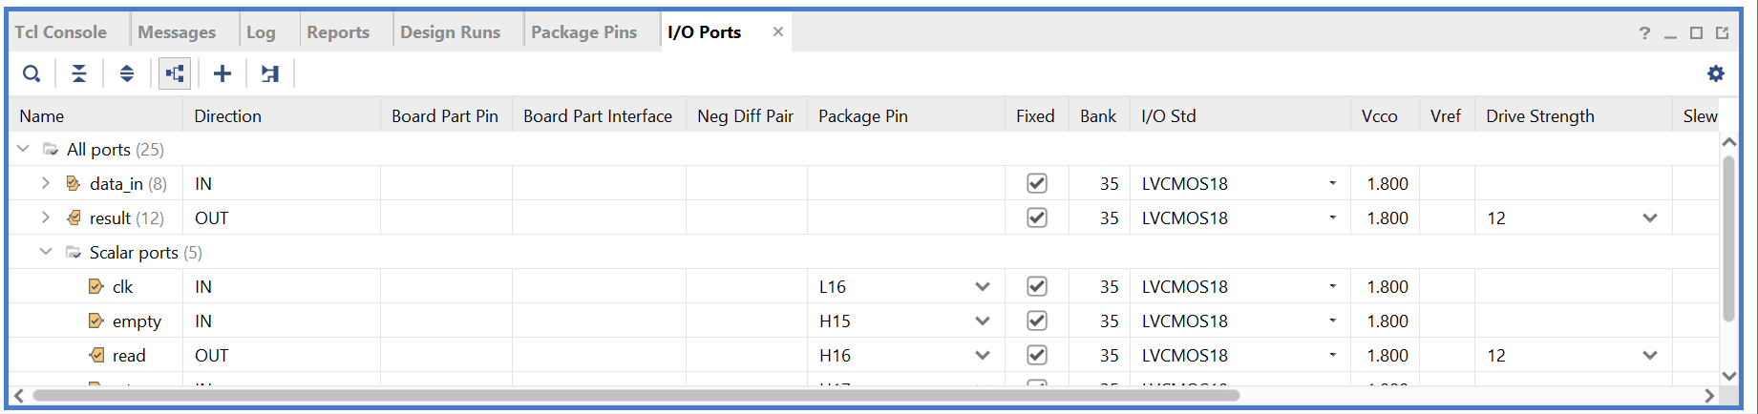
Lab 4: Overview and Introduction to Vivado
Lab 4
Step 37 – Ensure the IO Standard is set to LVCMOS18. Do not leave it as default because this will lead to a failure to implement and generate a bitstream.

Slide 45
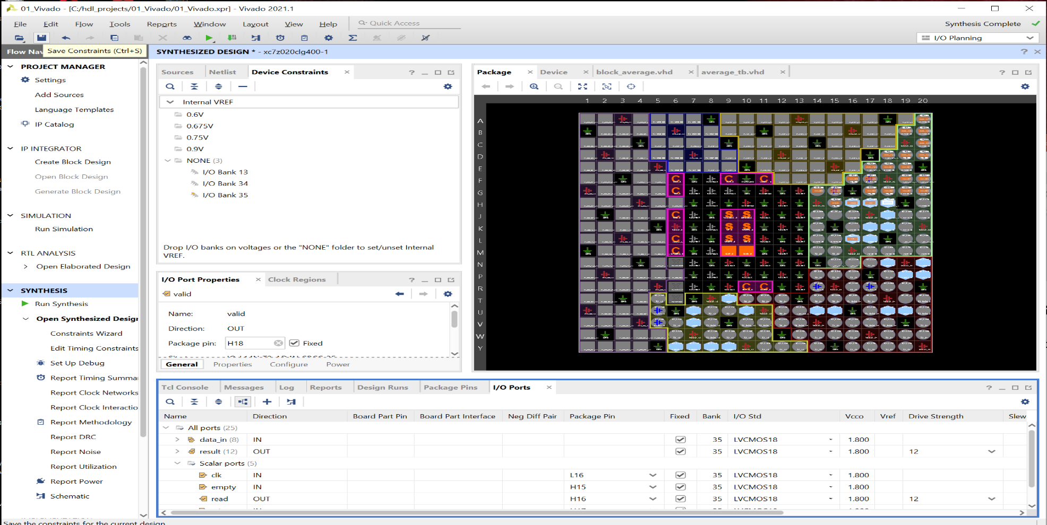
Lab 4: Overview and Introduction to Vivado
Lab 4
Step 38 – Save the Constraints we just edited.

Slide 46
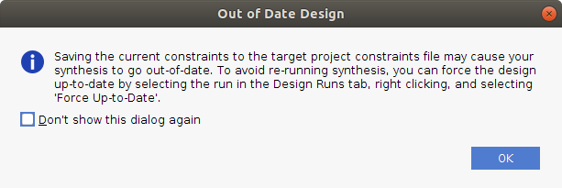
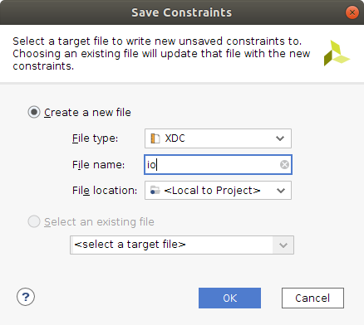
Lab 4: Overview and Introduction to Vivado
Lab 4
Step 39 – This will present two new dialogs. Click OK on the first and enter a file name for the second.

Slide 47
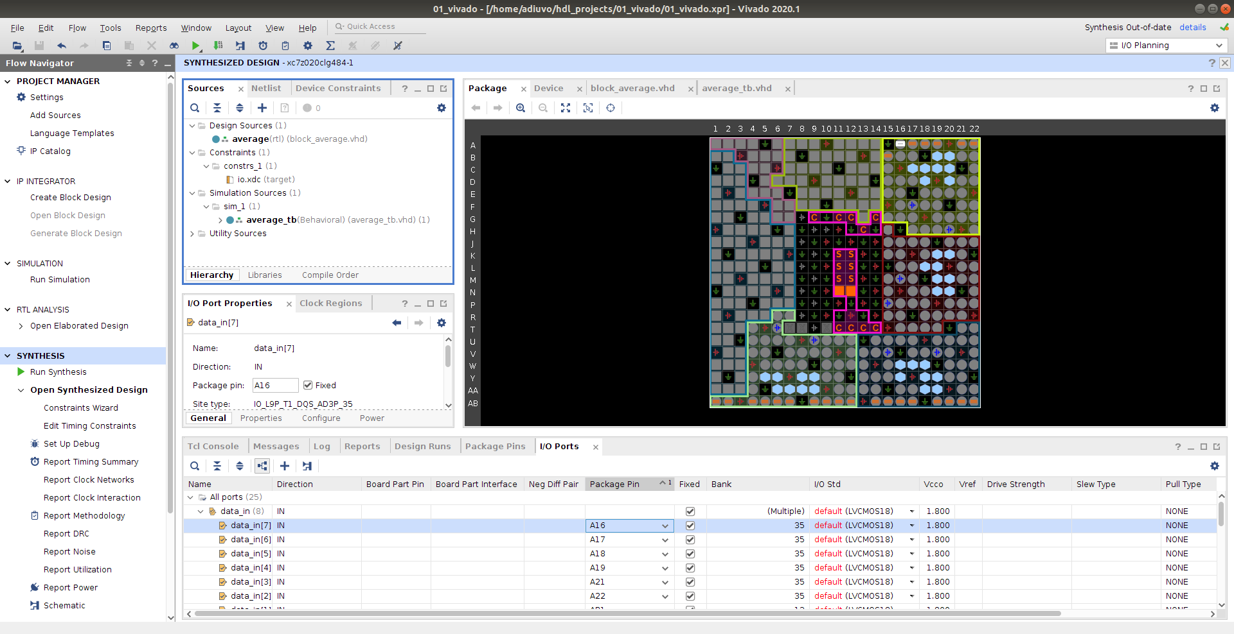
Lab 4: Overview and Introduction to Vivado
Lab 4
Step 40 – Close the Synthesis View.

Slide 48
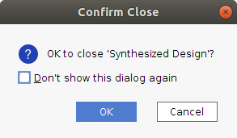
Lab 4: Overview and Introduction to Vivado
Lab 4
Step 41 – Confirm the decision to close by clicking OK. This will take us back to the project manager view.

Slide 49
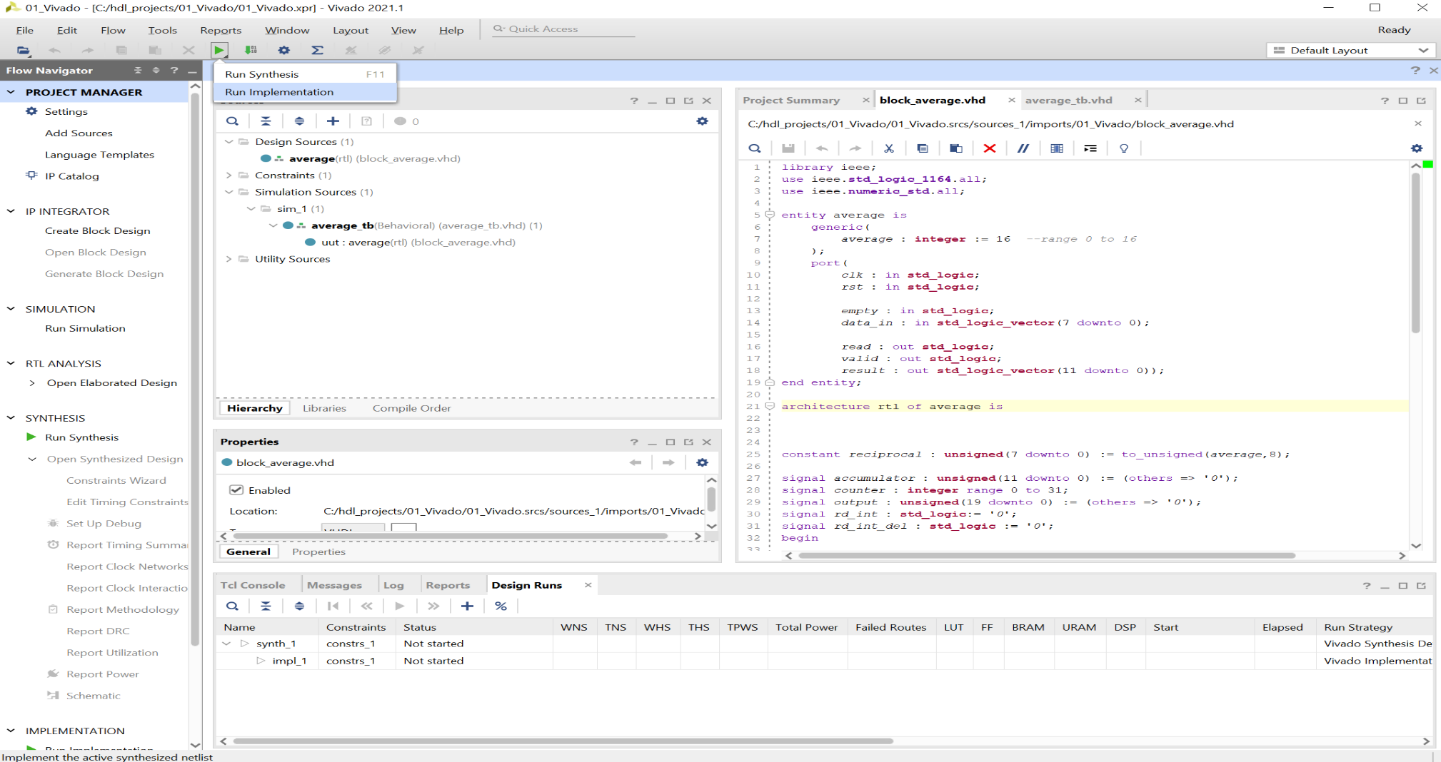
Lab 4: Overview and Introduction to Vivado
Lab 4
Step 42 – We are now ready to Run Implementation.

Slide 50
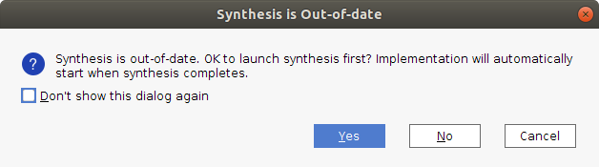
Lab 4: Overview and Introduction to Vivado
Lab 4
Step 43 – Click Yes when the Synthesis Out-of-Date dialog pops up.

Slide 51

Lab 4: Overview and Introduction to Vivado
Lab 4
Step 44 – Select OK on the Lunch Runs dialog.

Slide 52
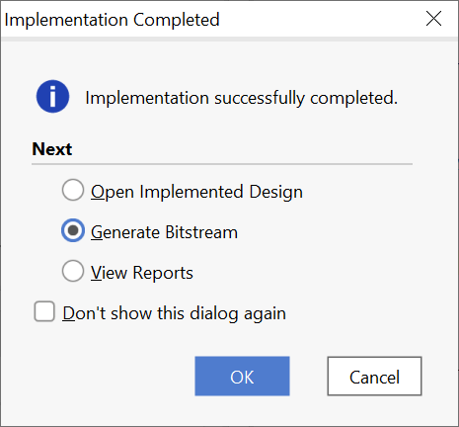
Lab 4: Overview and Introduction to Vivado
Lab 4
Step 45 – When the implementation completes, you will see a dialog appear. Select Generate Bitstream.

Slide 53
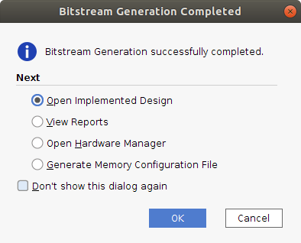
Lab 4: Overview and Introduction to Vivado
Lab 4
Step 46 – A dialog box will appear when the bitstream generates. Congratulations you have completed your first Vivado FPGA implementation.

Slide 54
Lab 5 Intermediate Vivado

Slide 55
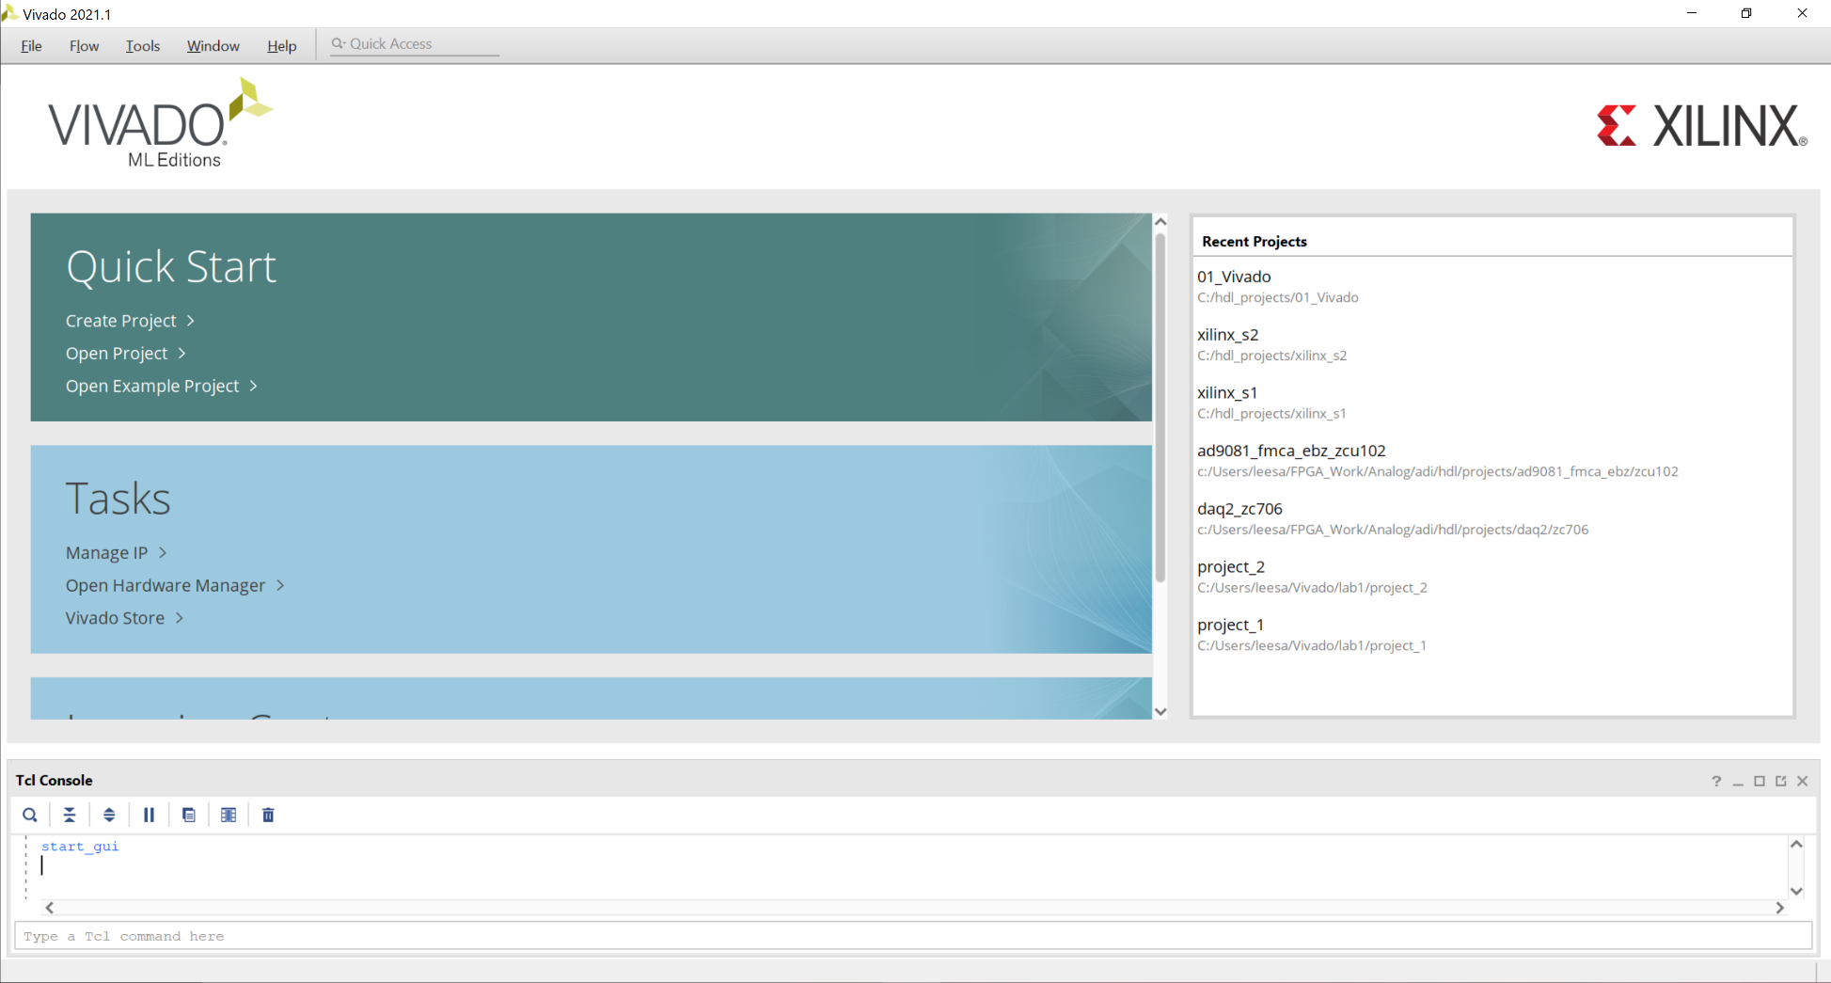
Lab 5: Intermediate Vivado
Lab 5
Step 1 – Open the project created in part one.

Slide 56
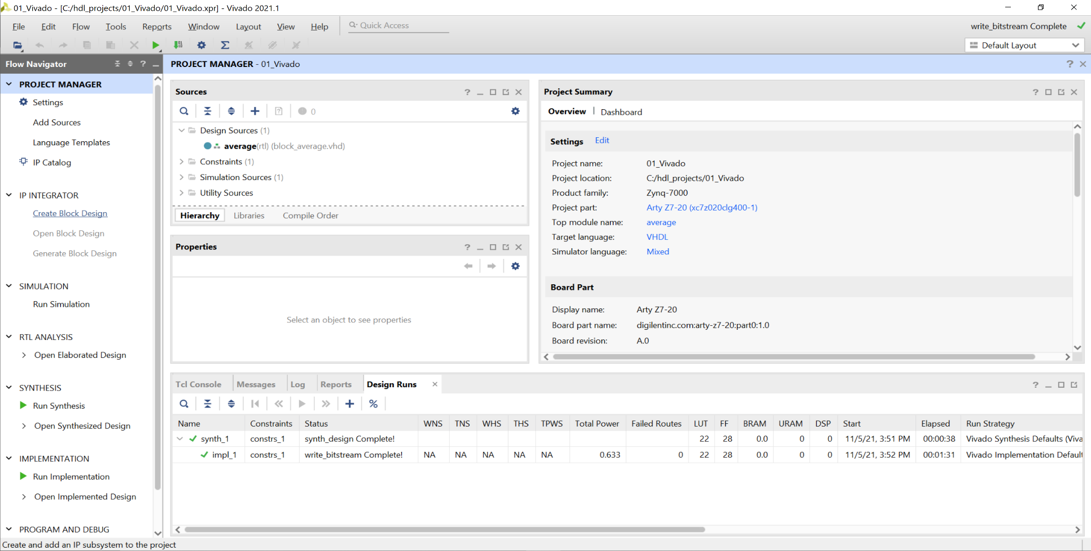
Lab 5: Intermediate Vivado
Lab 5
Step 2 – This will open in project management view. Click on Create Block Diagram.

Slide 57
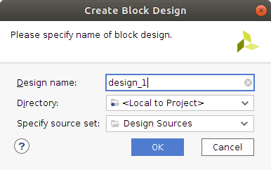
Lab 5: Intermediate Vivado
Lab 5
Step 3 – Leave the predefined name and locations unchanged and click OK.

Slide 58

Lab 5: Intermediate Vivado
Lab 5
Step 4 – Undock the block diagram window and maximize it.

Slide 59

Lab 5: Intermediate Vivado
Lab 5
Step 5 – We are going to add in new IP. Click on the + button.

Slide 60

Lab 5: Intermediate Vivado
Lab 5
Step 6 – Select the FIFO Generator. This will add a FIFO to the block diagram.

Slide 61

Lab 5: Intermediate Vivado
Lab 5
Step 7 – Double click on the FIFO Generator to customize it.

Slide 62

Lab 5: Intermediate Vivado
Lab 5
Step 8 – Leave the first page unchanged.

Slide 63

Lab 5: Intermediate Vivado
Lab 5
Step 9 – Change the Write and Read Width to be 8 bits.

Slide 64

Lab 5: Intermediate Vivado
Lab 5
Step 10 – Leave the third page unchanged.

Slide 65

Lab 5: Intermediate Vivado
Lab 5
Step 11 – Leave the fourth page unchanged.

Slide 66

Lab 5: Intermediate Vivado
Lab 5
Step 12 – Leave the final page unchanged. Note that the FIFO OP are unregistered. Click OK.

Slide 67

Lab 5: Intermediate Vivado
Lab 5
Step 13 – Click back on the Vivado Project Management view you will see the block diagram under the design sources.

Slide 68

Lab 5: Intermediate Vivado
Lab 5
Step 14 – Right click on the average RTL block and select Add Module to Block Design.

Slide 69

Lab 5: Intermediate Vivado
Lab 5
Step 15 – This will add the average block to the block diagram.

Slide 70

Lab 5: Intermediate Vivado
Lab 5
Step 16 – Expand the FIFO Write and Read Interfaces.

Slide 71

Lab 5: Intermediate Vivado
Lab 5
Step 17 – Make the Clk, Reset, Result, Valid and FIFO Write interfaces external by right-clicking on each pin and selecting Make External. Connect the remaining interfaces as below.

Slide 72
Lab 5: Intermediate Vivado
Lab 5
Step 18 – Click on Validate Design.

Slide 73

Lab 5: Intermediate Vivado
Lab 5
Step 19 – The validated design should result in no error or critical warnings. Click OK.

Slide 74

Lab 5: Intermediate Vivado
Lab 5
Step 20 – Re-dock the block diagram window into the Vivado Project Manager.

Slide 75

Lab 5: Intermediate Vivado
Lab 5
Step 21 – Click on the Zoom Fit button to fit the design to the window.

Slide 76

Lab 5: Intermediate Vivado
Lab 5
Step 22 – Right click on the block diagram design under the Design Sources tab and select Create HDL Wrapper.

Slide 77

Lab 5: Intermediate Vivado
Lab 5
Step 23 – Allow Vivado to manage the wrapper and click OK.

Slide 78

Lab 5: Intermediate Vivado
Lab 5
Step 24 – Expand the newly created wrapper and you will see the entire design.

Slide 79

Lab 5: Intermediate Vivado
Lab 5
Step 25 – Run the Synthesis.

Slide 80


Lab 5: Intermediate Vivado
Lab 5
Step 26 – On both resultant dialogs click OK and wait for synthesis to complete.

Slide 81
Lab 5: Intermediate Vivado
Lab 5
Step 27 – When synthesis completes, Open the Synthesized Design.

Slide 82

Lab 5: Intermediate Vivado
Lab 5
Step 28 – If any critical warnings pop up, select OK. This is due to out of data constraints which we are about to address.

Slide 83

Lab 5: Intermediate Vivado
Lab 5
Step 29 – Change the I/O standard from default to LVCMOS18.

Slide 84

Lab 5: Intermediate Vivado
Lab 5
Step 30 – Assign the clock input to pin L16. Assign all other IO to pins of your choice.

Slide 85

Lab 5: Intermediate Vivado
Lab 5
Step 31 – Click on Save Constraints.

Slide 86
Lab 5: Intermediate Vivado
Lab 5
Step 32 – If an out-of-date warning appears, click OK.

Slide 87

Lab 5: Intermediate Vivado
Lab 5
Step 33 – From the sources tab, open the IO constraints. You will see the old pin out for the previous project and your new project. This is because we have evolved the original project.

Slide 88

Lab 5: Intermediate Vivado
Lab 5
Step 34 – Select the old constraints (at the top of the file) and delete them. Save the file.

Slide 89

Lab 5: Intermediate Vivado
Lab 5
Step 35 –Run the Implementation, Re run synthesis if you get an out of date warning

Slide 90
Lab 5: Intermediate Vivado
Lab 5
Step 36 – Click OK to run the implementation.

Slide 91

Lab 5: Intermediate Vivado
Lab 5
Step 37 – Open the Block Design when design has built.

Slide 92

Lab 5: Intermediate Vivado
Lab 5
Step 38 – Select Constraints under Design Sources.

Slide 93

Lab 5: Intermediate Vivado
Lab 5
Step 39 – Click on the Add Source button.

Slide 94




Lab 5: Intermediate Vivado
Lab 5
Step 40 – Select Add or Create Constraints. Then Create File, enter the name “timing” for the file, and click Finish.

Slide 95

Lab 5: Intermediate Vivado
Lab 5
Step 41 – Right click on the newly created constraint file and select Set as Target Constraints File.

Slide 96

Lab 5: Intermediate Vivado
Lab 5
Step 42 – Open the implemented design. If you see the warning below click OK.

Slide 97

Lab 5: Intermediate Vivado
Lab 5
Step 43 – From the Tools menu, select Timing -> Constraints Wizard.

Slide 98


Lab 5: Intermediate Vivado
Lab 5
Step 44 – On the welcome screen, click Next and then enter 200 MHz for the clock frequency. Once done, select Skip to Finish.

Slide 99

Lab 5: Intermediate Vivado
Lab 5
Step 45 – On the final page, check that only one constraints is being created, check the View Timing Constraints, and click Finish.

Slide 100

Lab 5: Intermediate Vivado
Lab 5
Step 46 – Close the implementation view and rerun the implementation. Run synthesis if you get out of date pop up. Click OK on any dialogs which pop up prior to implementation starting.

Slide 101

Lab 5: Intermediate Vivado
Lab 5
Step 47 – Once the implementation completes, Timing will fail. Open the Implemented Design.

Slide 102

Lab 5: Intermediate Vivado
Lab 5
Step 48 – In the implemented design, select the failing Intra-Clock Paths.

Slide 103

Lab 5: Intermediate Vivado
Lab 5
Step 49 – Select Path 1 and zoom in. You will see that the FIFO output data passes through LUTs before finally being registered. This path is too long for timing at 200 MHz.

Slide 104

Lab 5: Intermediate Vivado
Lab 5
Step 50 – To fix this, we need to register the output of the FIFO. Close the implementation view and reopen the block diagram. Double click on the FIFO to customize.

Slide 105

Lab 5
Lab 5: Intermediate Vivado
Step 51 – Note the latency has changed from 1 to 2 clocks. We would need to correct for this in the average block, however, we proceed assuming that we have.

Slide 106

Lab 5: Intermediate Vivado
Lab 5
Step 52 – Reimplement the design. When the timing is completed, you should see that the implementation is correct and the timing is met.

